Slide 1
Programming with Java/Python
Anan Yaagoub - PhD
Northwestern University

Slide 2
Week 3 - Agenda
Functional programming
  comprehension, generator(s).
I/O and Parsing
  CSV, JSON, XML, HTML, PNG, XLS.
  RegEx
Scraping and WEB API
Threading
Extensions
  NumPy, matplotlib, Turtle, PIL, ..

Slide 3
What is Parallelism?
Performing multiple tasks (also known as processes) over a certain period of time by executing them concurrently.
Older OS – did not support any kind of concurrency
  Can open one application at a time
Cooperative-Work between the OS and the Programming language applications
Many Languages has frameworks to support parallel processing: Java, Python, ..

Slide 4
Parallelism Classification
Multitasking
  One processor doing multiple tasks at the same time
    Example: Eat, Phone call, and watch TV
    How?
      Context switching
Multiprocessing
  More than one processor working on a single task
    Example: Multiple Chefs …
    How?
      More than one CPU
      Multi-Core devices
      Computer nodes connected (Hadoop)

Slide 5
What is Multitasking/Concurrency?
Performing multiple tasks concurrently instead of executing the tasks sequentially.
As a result, a computer executes segments of multiple tasks in an interleaved manner, while the tasks share CPUs and main memory.
In the case of a computer with a single CPU:
  Only one task is said to be running at any point in time
  CPU is actively executing instructions for that task.
  Multitasking solves the problem by scheduling which task may be the one running at any given time, and when another waiting task gets a turn.
  The act of reassigning a CPU from one task to another one is called a context switch.

Slide 6
Multiprocessing
Many calculations are carried out simultaneously
Large problems can often be divided into smaller ones, which are then solved at the same time.
Parallel computing has become the dominant paradigm in computer architecture, mainly in the form of multi-core processors.
A Computational task is typically:
  broken down in several, often many, very similar subtasks
  that can be processed independently
  and whose results are combined afterwards, upon completion.

Slide 7
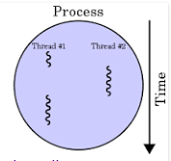
What is Threading
In computer science, a thread of execution is the smallest sequence of programmed instructions that can be managed independently by a scheduler, which is typically a part of the operating system.
A thread is a stream of instructions within a process.
  Each thread has its own instruction pointer,
  Set of registers
  Stack memory.
  The virtual address space is process specific, or common to all threads within a process.
  Data on the heap can be readily accessed by all threads

Slide 8
Using Parallelism Comes with …
Processing Overhead
  Creation and Setup time
  Threads Communication times
  Context switching time
New Type of Errors
  Data corruption
  Deadlocks
  Slower outcome with bad design

Slide 9
Parallelism Benefits
Best User Experience
  Processing speedup
  GUI Response time
Background tasks
  Disk read/write
  Network communication
  WEB API calls
Servers
  WEB servers
  Database servers
Graphics
  Heavily used in game development

Slide 10
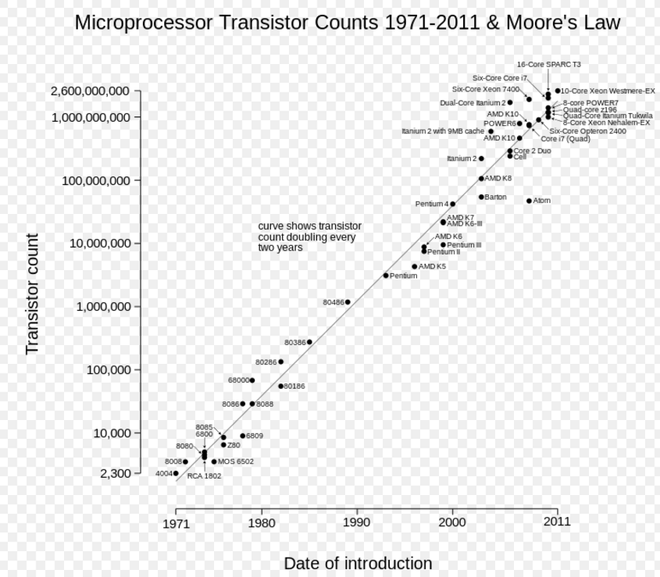
Moore’s Law -
"Moore's law" is the observation that, over the history of computing hardware, the number of transistors in a dense integrated circuit has doubled approximately every two years.
Speed is a Free Lunch

Slide 11
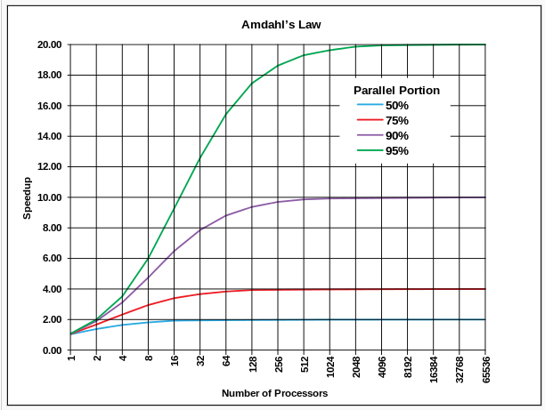
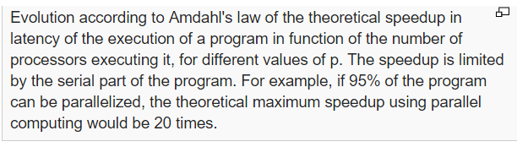
Amdahl’s Law
speed up of a program in parallel world is limited by the amount of serial part of the program

Slide 12
When to think parallel
Does it work for all tasks?
Candidate for parallelism:
  CPU intensive operations
  Sorting, search, filtering aggregation
  Background jobs … networking or saving file in background
Where not: network I/O ... have to wait … cannot speed that!

Slide 13
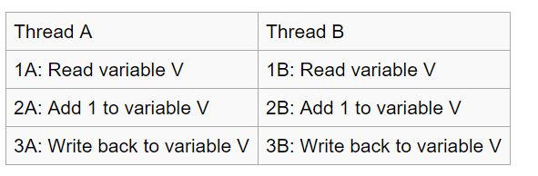
Race Conditions
When threads share access to a common object, they can conflict with each other.
Each thread has its own local variables, and can share variables.
That shared access creates a problem. This problem is often called a race condition.
Instructions level example
Example: Week09_2 project
To solve race condition problem, use a lock objec

Slide 14
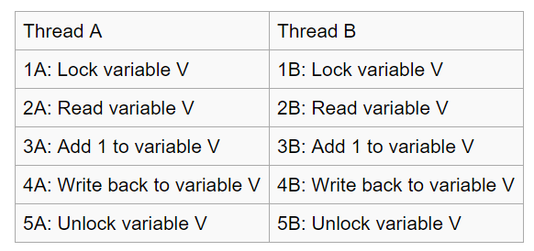
Race Conditions
When threads share access to a common object, they can conflict with each other.

Slide 15
Synchronizing Object Access …
When a thread calls the lock method, it owns the lock until it calls the unlock method.
If a thread calls lock while another thread owns the lock, the first thread is temporarily deactivated.
The thread scheduler periodically reactivates such a thread so that it can again try to acquire the lock.
If the lock is still unavailable, the thread is again deactivated.
Eventually, when the lock is available because the original thread unlocked it, the waiting thread can acquire the lock.

Slide 16
Python Parallelism
Multitasking
  threading library
Multiprocessing
  multiprocessing library

Slide 17
Python Threading library Classes
Thread
Lock
RLock
Condition
Event
Timer

Slide 18
Thread Creation - I
Create Thread object
  t = Thread(target=myFunction, args = (arg1,arg2))
  t.start()
  t.join()
Threads can share resources, variables, …
Example: thr_create1.py

Slide 19
Thread Lock
Create Lock object and call its methods
  tLock = threading.Lock()
  tLock.acquire()
  Do work …
  tLock.release()
Example: thr_lock.py

Slide 20
Thread creation - II
Create a class
Inherit from threading.Thread
Override the run() method
Create an instance of your class
Call the start method
Example: thr_async_write.py

Slide 21
Thread Monitoring
Use threading class methdos
  threading.active_count()
  threading.current_thread
  threading.main_thread
  threading.TIMEOUT_MAX (locking)
  ….

Slide 22
Threading Example – Web API
Extract stock prices for selected list of companies
Store the data in a database
Demonstrate
  Improved performance
  Use of Locking
  Write to Database (MySQL)
Example: thr_stocks.py
DB: thr_stocks_2_DB.py

Slide 23
Multiprocessing - Parallelism in Python
Problem with Python: it is interpreter written to be a single threaded application
It has global variables lock
Python can use only one core
Exception: some C extensions like numpy do release the locks
How to get around the GIL
  Create more instance of python programs
  Instance run independently
  No share memory (OS restriction)
  Each instance has one thread
  Pass data among the different process using pickle serializations

Slide 24
Python
Thread-based parallelism library
  Cooperative concurrency on a single native thread
  https://docs.python.org/3/library/threading.html
Process-based parallelism library
  Python is an interpreter written as a single threaded application
  GIL – Global Interpreter Locks
  prevents multiple native threads from executing Python bytecodes at once
  https://docs.python.org/3.5/library/multiprocessing.html

